Slide 1
BPS Accreditation: Revised standards for Clinical Psychology Training Programmes
Supporting and tracking the development of specific competency areas

Slide 2
Aims of this presentation
To orient Salomons’ placement supervisors to changes arising from the revised BPS criteria for accreditation of training programmes
To provoke thought about the competencies involved in clinical psychology practice
To equip supervisors to support trainees to meet the new requirements

Slide 3
Overview
Context and rationale for the changes
Value of the changes for different stakeholders
Overview of the new placement paperwork and the competency frameworks
A more detailed look at systemic competencies, to illustrate the use of observation and feedback
A model-specific framework in action
Video examples
Role play exercise

Slide 4
Key new BPS requirements
Monitoring of development of trainees’-
Model-specific competencies (MSCs) for CBT and at least one other model
Psychometric and neuropsychological testing competencies
Leadership and systems-based influence

Slide 5
Why? Current contexts for CP
To improve the quality of training outcomes through better tracking of development and training needs
To increase the employability of CPs by clear documentation of their specific competencies and diverse range of skills
To assist CPs who seek therapy-specific accreditation in the future by providing clear evidence of skills and experience

Slide 6
MSCs and terminology
MSCs are sets of defined skills and knowledge that are required to deliver therapy or other psychological intervention according to a specific model
MSCs may be involved in interventions with individuals, groups, families and wider systems
Benchmarked competency frameworks setting out MSCs for different models of practice have been developed in recent years

Slide 7
MSCs and clinical psychology
BPS minimum = CBT plus one other therapy model
Clinical psychology practice = therapy MSCs plus “beyond therapy” MSCs
In responding to the BPS criteria, Salomons has adopted the broader clinical psychology approach to MSCs

Slide 8
The Salomons’ response: 1. Formal assessment
One set of therapy model-specific competencies (MSCs) are assessed in the 1st. Year Assessment of Clinical Skills (the old Portfolio)
Trainees are required to illustrate MSCs in their PPRs, one of which must be an extended assessment

Slide 9
The Salomons’ response: 2. Focussing practice learning
On placement, trainees will record the development of therapy and “beyond therapy” MSCs, logging psychometric experience and systems/leadership work more extensively
Supervisors will have an increased focus in supporting and validating trainees’ development of MSCs, psychological testing and organisational work

Slide 10
The Salomons’ response: 3. Curriculum cross-referencing
MSCs, psychological testing and leadership and organisational work will be cross-referenced across domains of training and time (eg. in written assessments, in training reviews and mid-placement visits, in placement descriptions and allocation)

Slide 11
Brief exercise
Consider why these developments might be helpful for:
Trainees
Supervisors
Teams and services
Service users and carers
The profession

Slide 12
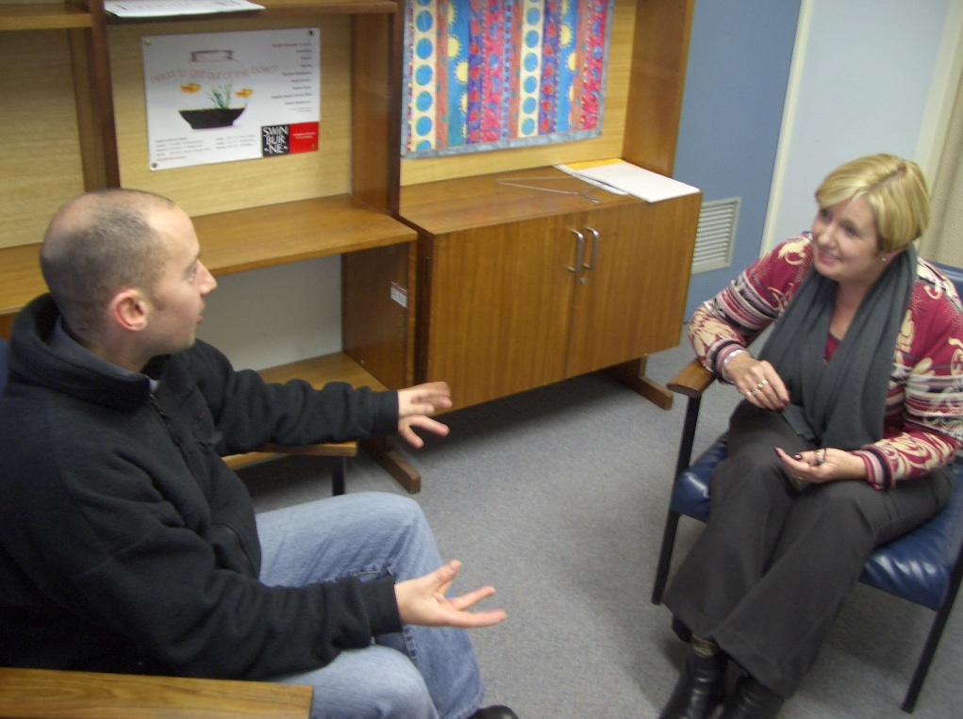
Implications for placements

Slide 13
Implications for placements
Changes to the Evaluation of Clinical Competence (ECC) form
Changes to the Practice Learning Portfolio
(PLP, formerly the Log Book)
Introduction of competency frameworks:
CBT
Psychodynamic
Systemic
Leadership
Community and critical psychology

Slide 14
The revised ECC form
Formative summary of observed MSC and associated feedback
Reduced emphasis on qualitative feedback for passed competencies
Some amended headings to better reflect competencies under discussion e.g. “Organisational and systems influence and leadership”

Slide 15
The Practice Learning Portfolio
All parts are held and completed by the trainee but signed off by the supervisor:
New sections to log organisational and leadership experience and initiatives
New section to describe any public education / community engagement activities
Introduction of MSC condensed competency frameworks to provide a cumulative record of experience and learning
Introduction of a new log of psychological testing

Slide 16
MSC competency frameworks
Six frameworks provide the trainee with a record to:
Track development and training needs
Document skills for future employment
Evidence skills and experience for therapy-specific accreditation in the future
They also provide scaffolding for trainees and supervisors to discuss feedback on observed and reported MSC

Slide 17
Observation* of MSC
Supervisors are already observing trainees’ therapy sessions and giving feedback
The new ECC and PLP increase emphasis on MSCs relevant to these observed sessions
A specific supervision session following an observed session, should happen at least once in each placement. Its focus should be on discussion of how the trainee used MSCs and areas for development.
* “Observation” includes recorded sessions

Slide 18
Examples of competency frameworks

Slide 19
Competency frameworks: Health warning number 1
There is no expectation that trainees will develop all competencies on your placement or even during 3 years of training.
Trainees will have their own pathways and competency profiles, according to interests and opportunities.

Slide 20
Competency frameworks: Health warning number 2
Supervisors do not have to organise any special work outside the usual range of clinical psychology practice. The competency frameworks aim to provide the opportunity for trainees to record (and have recognised) their competencies within usual practice.
Model-specific competencies can be identified and noticed within integrated work, indirect work with staff and teams, and other forms of complex work

Slide 21
MSC competency frameworks
CBT
Psychodynamic
Systemic
Leadership
Community and critical psychology
Anchored in CORE or BPS frameworks, or adapted from those provided by therapy accreditation bodies.
A CAT framework is also being developed

Slide 22
CBT condensed framework: Example
Area of Competence | Emerging | Establishing | Consolidating
Specific techniques e.g. Guided discovery Cognitive interventions (cognitive change diaries, continua, responsibility charts, evaluating alternatives, examining pros/cons, imagery restructuring, reliving and re-scripting) Behavioural interventions (behavioural activation, activity diaries, behavioural experiments, role play, graded exposure, ERP, graded task assignments, modelling, applied relaxation, controlled breathing etc.) Adapting interventions to the client (a meta-competency) Selecting most appropriate interventions (a meta-competency) Timing of interventions (a meta-competency)
Optional examples of how this competency was demonstrated: Placement code: Example/s:

Slide 23
Psychodynamic condensed framework: Example
Area of Competence | Emerging | Establishing | Consolidating
A5. Ability to understand and maintain an appropriate psychodynamic attitude and focus towards clinical work: including an ability to facilitate the exploration of unconscious dynamics influencing relationships. including an ability to work with the client’s internal and external reality, linking these as necessary. including an awareness of and ability to work with unconscious communication/motivation in client and self. including an ability to be mindful of and work within the distinct phases of therapy, with due regard to the importance of engagement and termination.
Optional examples of how this competency was demonstrated: Placement code: Example/s:

Slide 24
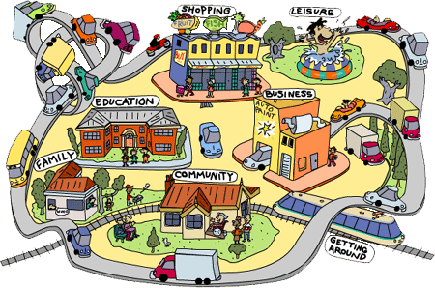
Competencies beyond therapy

Slide 25
Competencies beyond therapy
Leadership
Community and critical psychology
Psychological testing

Slide 26
Leadership framework
Covers the following areas:
Clinical leadership competencies
Professional competencies
Strategic competencies

Slide 27
Leadership condensed framework: Example
Area of Competence | Emerging | Establishing | Consolidating
Clinical Leadership Competencies e.g. Broad knowledge of psychological models to inform own and team’s formulation and interventions. Psychological perspective on multifarious health and mental health presentations Emotional Intelligence/resilience Self-reflection/helping others self reflect. Reflection and awareness of systemic issues operating within teams/able to lead team dynamics discussions. An understanding of the emotional impact of change (including resistance). Encourage team reflection on current/innovative practice
Optional examples of how this competency was demonstrated: Placement code: Example/s:

Slide 28
Critical/community framework
Covers the following areas:
Application of community and critical psychology principles to achieve second order change
Community level interventions
Working for community and social change
Community research
This framework links with a new section in the PLP on Community Engagement

Slide 29
Community/ critical psychology: Example
Area of Competence | Emerging | Establishing | Consolidating
Community Level Interventions e.g. Community Partnership: The ability to work in partnership with community stakeholders to plan, develop, implement and manage projects. Prevention and Health Promotion: The ability to articulate and implement a prevention perspective, and to implement prevention and health promotion interventions. Group facilitation: The ability to facilitate productive group and inter-group processes even in the presence of power differentials or conflict, supporting participatory decision-making and co-production.
Optional examples of how this competency was demonstrated: Placement code: Example/s:

Slide 30
Brief exercise
Take 5 minutes to consider ideas and opportunities for public / community engagement in your service

Slide 31
Psychological testing log
Stage of Training | Test Used | Age of Client | Clinical Use (reason for testing - outcome measure, treatment planning, eligibility) | Administration |  |  | Interpretation
 |  |  |  | Emerg-ing | Establi- shing | Consol-idating | Emer-ging | Establ- ishing | Consol-idating

Slide 32
Using the systemic framework for observation and feedback: an example

Slide 33
Using the systemic framework for observation and feedback: an example
The framework should be used flexibly and inclusively, not just for family therapy
Examples of use in practice include:
Using genograms and circular questions in individual therapy
Showing awareness and understanding of the GRRAACCES in a supervision session
Bringing a relational perspective to discussions in a team context
The framework guides a developmental discussion (it is not a “rating” scale)

Slide 34
Website resources
This link will take you to the section of our website that contains all the supporting documentation:
http://www.canterbury.ac.uk/social-and-applied-sciences/salomons-centre-for-applied-psychology/programmes/doctorate-in-clinical-psychology/resources.aspx
Select documentation relating to the 2016 intake of trainees onwards.

